Slide 1

Comprehensive Audit and Analysis for Effective Digital Presence
(Website Audit, Digital Marketing Strategy & Landing Page Design)
By
T. Kavitha Jayendran
GUVI CAPSTONE PROJECT 2026

Slide 2
Project Overview
Objective
To evaluate a company's digital presence by analyzing its website, digital marketing strategies, and user experience. The project also focuses on designing an effective landing page to improve user engagement, lead generation, and brand visibility.
Project Workflow
  Company Selection
  Website Audit (Design, UX & SEO)
  Digital Marketing Strategy Analysis
  Landing Page Design
  Recommendations for Improvement
Project Outcome
Evaluate Website Performance
Identify Improvement Areas
Recommend Marketing Strategies
Design High-Converting Landing Page

Slide 3

COMPANY PROFILE
Zoho Corporation Pvt. Ltd
Particulars | Details
Company Name | Zoho Corporation Pvt. Ltd.
Industry | Software as a Service (SaaS)
Founded | 1996
Headquarters | Chennai, Tamil Nadu, India
Founders | Sridhar Vembu & Tony Thomas
Products | CRM, Books, Mail, Projects, People, Desk, Creator and more
Website | www.zoho.com
🌍 150+ Countries Served
👥 Millions of Global Users
💼 55+ Business Applications
🏢 Headquarters: Chennai, India
💻 Strong Digital Presence

Slide 4
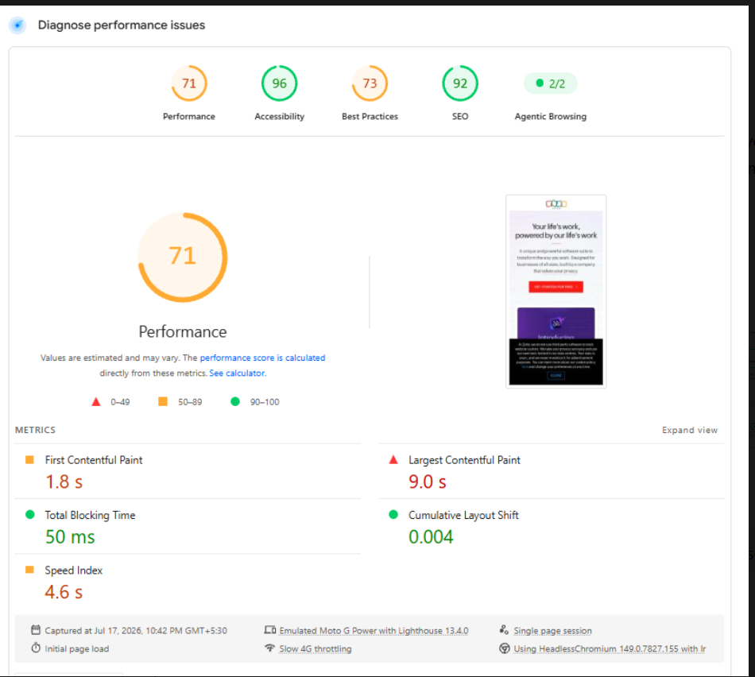
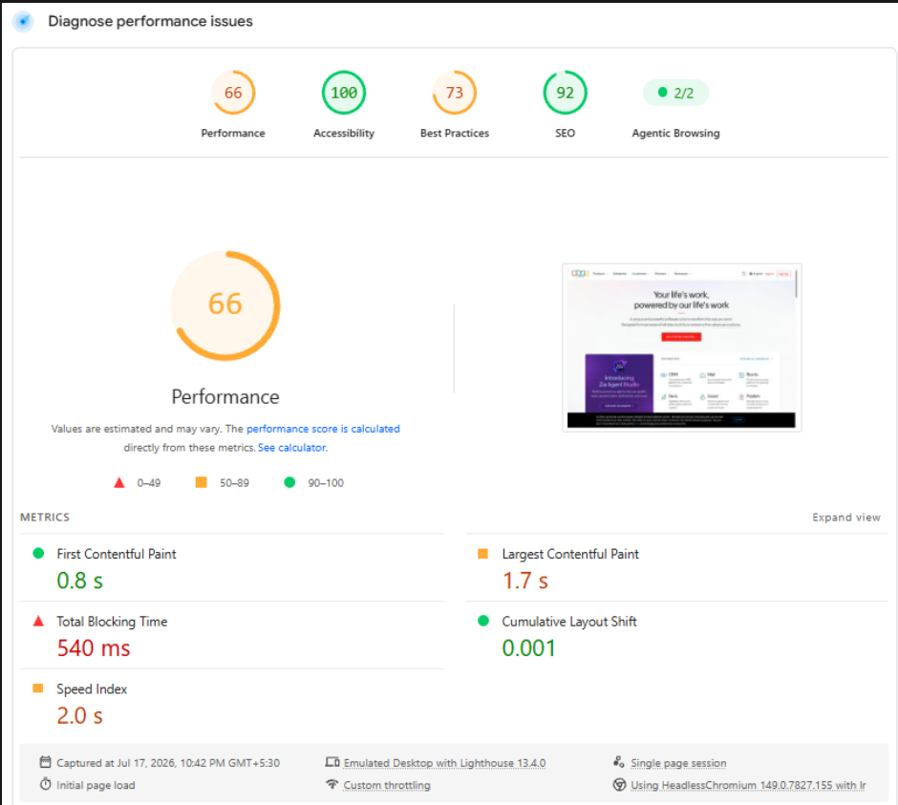
WEBSITE AUDIT OVERVIEW
Criteria | Mobile | Desktop
Performance | 🟡 71 | 🟡 66
Accessibility | 🟢 96 | 🟢 100
Best Practices | 🟡 73 | 🟡 73
SEO | 🟢 92 | 🟢 92
Core Web Vitals | ❌ Failed | ✅ Passed
Key Observation
Zoho demonstrates excellent SEO and accessibility scores. However, performance optimization is needed, particularly for mobile devices

Slide 5
WEBSITE AUDIT
Audit Criteria | Rating | Observation
🎨 Website Design | ⭐⭐⭐⭐⭐ | Clean, modern, and visually appealing layout
🧭 Navigation | ⭐⭐⭐⭐⭐ | User-friendly menu with clear navigation options.
👤 User Experience (UX) | ⭐⭐⭐⭐⭐ | Easy to explore products and services with an intuitive interface.
📱 Mobile Responsiveness | ⭐⭐⭐⭐⭐ | Fully responsive across devices
⚡ Website Speed | ⭐⭐⭐⭐☆ | Fast loading with minor optimization opportunities
🔍 SEO | ⭐⭐⭐⭐☆ | Well-optimized titles, meta tags, and headings
🎯 Call-to-Action (CTA) | ⭐⭐⭐⭐⭐ | Clear and strategically placed CTA buttons
Accessibility | ⭐⭐⭐⭐☆ | Good readability and accessibility features

Slide 6
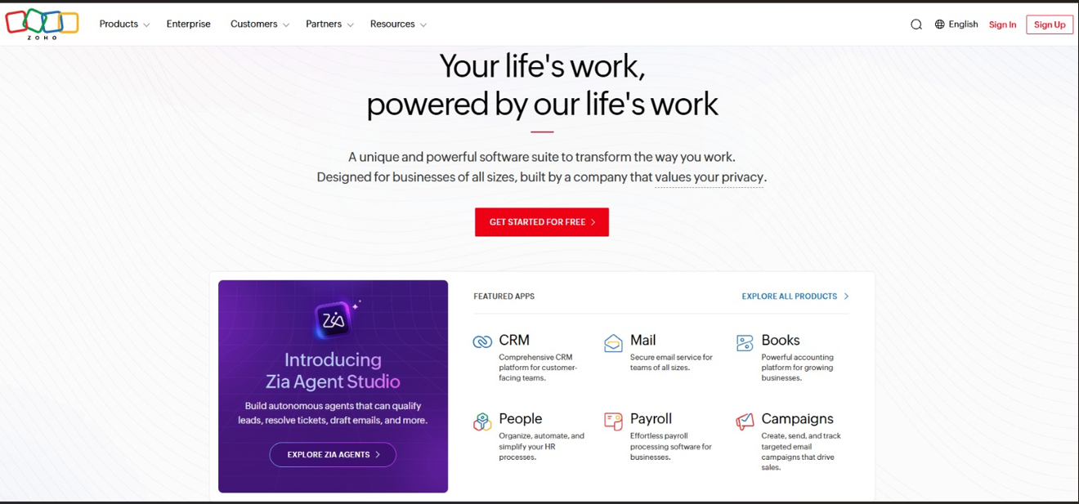




Website Audit Findings
🎨 Website Design
  Modern and professional interface.
  Featured Apps section highlights key products effectively.
  "Explore Zia Agent" attracts user attention with a prominent hero section.
  Consistent branding and high-quality visuals.
🎯 Call-to-Action (CTA)
  button is clearly visible on the homepage.
  Encourages visitors to try Zoho's products immediately.
  Strategically placed to improve lead generation.
Get Started for Free
🔍 SEO Analysis
  Optimized page titles
  Relevant meta descriptions
  Proper heading hierarchy
  SEO-friendly URLs
👤 User Experience (UX)
  User-friendly navigation menu.
  Well-organized content structure.
  Products and services are easy to locate.
  Simple and intuitive browsing experience.

Slide 7

PERFORMANCE ANALYSIS
Strengths ✅
Excellent Accessibility (96–100)
Strong SEO (92)
Responsive website design
Stable layout with minimal layout shift
Clear navigation and effective CTA placement
Areas for Improvement ⚠️
  Improve overall performance score
  Optimize images for faster loading
  Reduce unused CSS & JavaScript
  Minimize render-blocking resources
  Reduce third-party scripts and browser errors
Overall Assessment
🟢 Strong website with excellent SEO and accessibility.
🟡 Performance can be further optimized for a better user experience

Slide 8
Website Strengths & Weaknesses (SWOT)
Strengths
Excellent SEO
Strong Accessibility
User-friendly navigation
Professional branding
Weaknesses
Performance score can improve
Heavy page resources
Mobile Core Web Vitals failed
Third-party scripts
Opportunities
Improve mobile speed
AI personalization
Interactive demos
Threats
Competitors with faster websites
Increasing user expectations
Search ranking affected by slow pages

Slide 9
Digital Marketing Strategy
Objective
Analyze Zoho's current marketing activities, evaluate its digital presence, and recommend strategies to improve brand awareness and lead generation.

Slide 10
CURRENT MARKETING ACTIVITIES
Traditional Marketing
🏢 Technology Conferences & Business Events
🤝 Partner & Reseller Programs
🎤 Product Demonstrations
📄 Corporate Brochures & Sales Materials
👥 Direct Sales & Enterprise Meetings
🎓 Customer Training Programs
OBSERVATION
Zoho primarily focuses on digital marketing while using traditional marketing to strengthen enterprise relationships and brand credibility.
Digital Marketing
🌐 Search Engine Optimization (SEO)
📱 Social Media Marketing
✍️ Content Marketing (Blogs & Articles)
📧 Email Marketing
▶️ Webinars & YouTube Videos
💼 LinkedIn Marketing

Slide 11
DIGITAL MARKETING CHANNELS
🌐 SEO
SEO Score: 92/100
✍️ Content Marketing
Blogs, Guides & Case Studies
📱 Social Media
LinkedIn, X, Facebook, YouTube
🎯 Lead Generation
Free Trial, Demo Requests & Contact Forms
📧 Email Marketing
Product updates, newsletters & campaigns
🎥 Webinars
Product demos & training
Key Insight
Zoho integrates multiple digital channels to attract, engage, and convert customers throughout the buyer journey.

Slide 12
RECOMMENDATIONS
🚀 SEO
  Improve mobile page speed.
  Optimize images and page loading.
  Reduce render-blocking resources.
📱 Social Media
  Increase short-form educational videos.
  Share more customer success stories.
🎯 Lead Generation
  Add interactive product demos.
  Enhance chatbot support.
  Optimize landing page conversion rate.
✍️ Content Marketing
  Publish industry case studies.
  Expand AI and automation-related blogs.
📧 Email Marketing
  Personalize email campaigns.
  Improve lead nurturing workflows

Slide 13
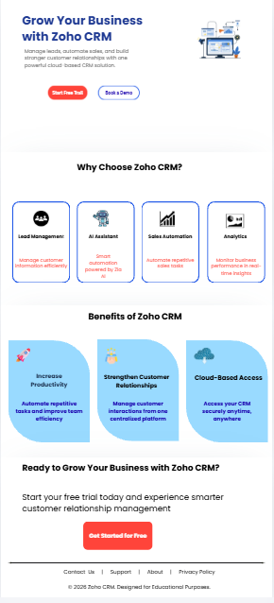
LANDING PAGE DESIGN
Designed using Canva for lead generation.
Highlights Zoho CRM features and benefits.
Includes clear call-to-action buttons.
User-friendly layout with a clean and responsive design.

Slide 14
Conclusion
Project Achievements
Evaluated Zoho's website design, UX, SEO, and performance.
Identified strengths and improvement opportunities through website audit.
Analyzed traditional and digital marketing strategies. Proposed practical recommendations to improve digital presence.
Designed a lead-generation-focused Zoho CRM landing page.
This project demonstrates how a well-designed website, an effective digital marketing strategy, and an optimized landing page together contribute to improving user experience, customer engagement, and overall business growth.

